Slide 1
COSE472(00): Information Retrieval (정보검색) Lecture 1. Basics of Web Search
Instructor: Jaegul Choo (주재걸)
jchoo@korea.ac.kr

Slide 2
Web Search and Web Search Engines
Web search is to find materials on the World Wide Web that satisfy an information need.
A web search engine is a software system designed for web search:
1993: W3Catalog
1994: Webcrawler, Infoseek, Lycos, go.com
1995: Yahoo!, Altavista->Yahoo!, Excite
1997: Northen Light, Yandex
1998: Google, MSN Search
2000: Baidu
2004: Yahoo! Search, Sogou
2006: Live Search
2009: Bing
Notes:
Can be viewed as a table.

Slide 3
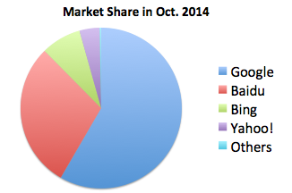
Web Search and Web Search Engines
Notes:
Can be viewed as a table.

Slide 4
How to Search Documents?
1 if play contains word, 0 otherwise
Term-document incidence matrix
For boolean query “Brutus AND Caesar AND NOT Calpurnia"
110100 AND 110111 AND 101111 = 100100
Notes:
Can be viewed as a table.

Slide 5
Issues of term-document incidence matrix
Building such an incidence matrix is infeasible for large collections.
For example,
Consider 1 million documents, each with about 1,000 words.
Assume 6 bytes/word, storing all documents consumes 6GB space.
Assume 500K distinct terms
500K x 1M matrix has half-a-trillion 0’s and 1’s.
There should be roughly one billion 1’s only. The incidence matrix is extremely sparse.
Is there a better solution?
Inverted Index
Notes:
Can be viewed as a table.

Slide 6
Inverted Index
An inverted index consists of a dictionary and postings.
For each term T in the dictionary, we store a list of documents (document IDs) containing T.
Posting
Brutus
1
2
4
11
31
45
173
174
Caesar
1
2
4
5
6
16
57
132
Calpurnia
2
31
54
101
Dictionary
Postings
Sorted by docID (more later on why).
6
Notes:
Can be viewed as a table.

Slide 7
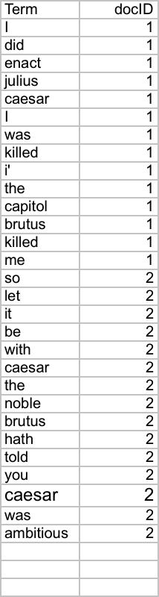
Indexer steps: Token sequence
Sec. 1.2
Sequence of (Modified token, Document ID) pairs.
Doc 1
Doc 2
I did enact Julius
Caesar I was killed
i’ the Capitol;
Brutus killed me.
So let it be with
Caesar. The noble
Brutus hath told you
Caesar was ambitious

Slide 8
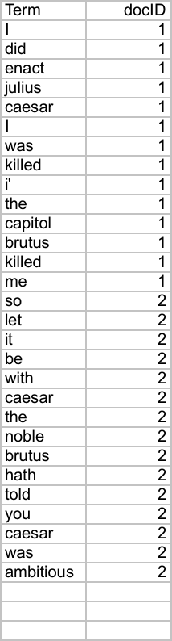
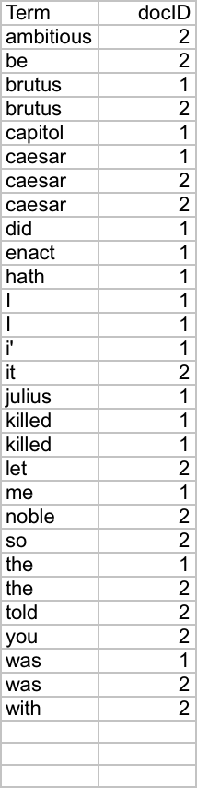
Indexer steps: Sort
Sec. 1.2
Sort by terms
And then docID
Core indexing step

Slide 9
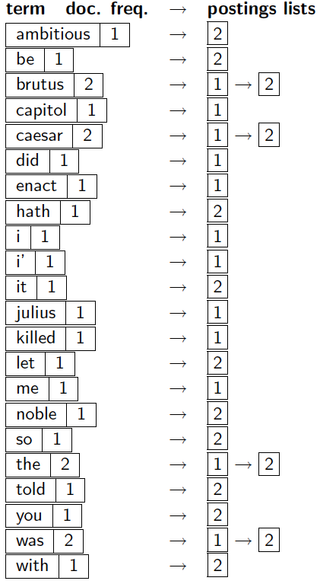
Indexer steps: Dictionary & Postings
Sec. 1.2
Multiple term entries in a single document are merged.
Split into Dictionary and Postings
Doc. frequency information is added.
Why frequency?
Will discuss later.

Slide 10
Where do we pay in storage?
Sec. 1.2
Lists of docIDs
Terms and counts
IR system implementation
How do we index efficiently?
How much storage do we need?
Pointers

Slide 11

Processing Boolean queries
What are the documents contains “Brutus AND Calpurnia"?
Locate Brutus in the Dictionary
Retrieve its postings
Locate Calpurnia in the Dictionary
Retrieve its postings
Intersect the two postings lists
If the list lengths are x and y, the merge takes O(x+y) operations.
Important: postings sorted by docID.
Notes:
Can be viewed as a table.

Slide 12
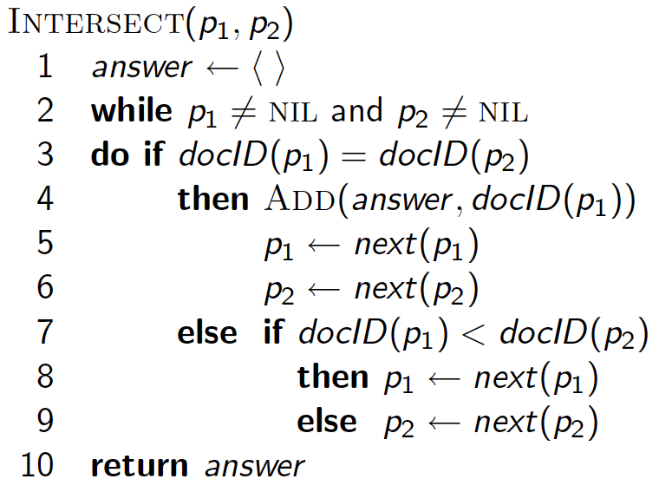
Intersecting two postings lists (a “merge” algorithm)

Slide 13
Phrase queries
Sec. 2.4
We want to be able to answer queries such as “stanford university” – as a phrase
Thus the sentence “I went to a university at Stanford” is not a match.
The concept of phrase queries has proven easily understood by users; one of the few “advanced search” ideas that works
Many more queries are implicit phrase queries
For this, it no longer suffices to store only
<term : docs> entries

Slide 14
A first attempt: Biword indexes
Sec. 2.4.1
Index every consecutive pair of terms in the text as a phrase
For example the text “Friends, Romans, Countrymen” would generate the biwords
friends romans
romans countrymen
Each of these biwords is now a dictionary term
Two-word phrase query-processing is now immediate.

Slide 15
A first attempt: Biword indexes
Sec. 2.4.1
For multi-word phrase query such as "A B C D", we may use Boolean query "A B" AND "B C" AND "C D“
False positive: "A B B C C D" is a match
larger index size (single-word + Bi-word dictionary)

Slide 16
Solution 2: Positional indexes
Sec. 2.4.2
In the postings, store, for each term the position(s) in which tokens of it appear:
<term, number of docs containing term;
doc1: position1, position2 … ;
doc2: position1, position2 … ;
etc.>

Slide 17
Positional index example
Sec. 2.4.2
<be: 993427;
1: 7, 18, 33, 72, 86, 231;
2: 3, 149;
4: 17, 191, 291, 430, 434;
5: 363, 367, …>
Which of docs 1,2,4,5
could contain “to be
or not to be”?
For phrase queries, we use a merge algorithm recursively at the document level
But we now need to deal with more than just equality

Slide 18
Processing a phrase query
Sec. 2.4.2
Extract inverted index entries for each distinct term: to, be, or, not.
Merge their doc:position lists to enumerate all positions with “to be or not to be”.
to:
2:1,17,74,222,551; 4:8,16,190,429,433; 7:13,23,191; ...
be:
1:17,19; 4:17,191,291,430,434; 5:14,19,101; ...
Same general method for proximity searches

Slide 19
Proximity queries
Sec. 2.4.2
STATUTE /3 FEDERAL /2 TORT
/k means “within k words of”.
Clearly, positional indexes can be used for such queries; biword indexes cannot.

Slide 20
Positional index size
Sec. 2.4.2
A positional index expands postings storage substantially
Even though indices can be compressed
Nevertheless, a positional index is now standardly used because of the power and usefulness of phrase and proximity queries … whether used explicitly or implicitly in a ranking retrieval system.

Slide 21

Inverted Index Construction
Documents to
be indexed
Friends, Romans, countrymen.
Tokenizer
Tokenize the texts
Friends
Romans
Countrymen
Linguistic modules
Normalize tokens
friend
roman
countryman
Indexer
friend
2
4
roman
1
2
Inverted index
countryman
13
16
Notes:
Can be viewed as a table.

Slide 22
Tokenization
Cut character sequence into word tokens
Complications:
"Hewlett-Packard" -> "Hewlett" and "Packard" as two separate tokens?
“State-of-the-art”
Numbers often are not indexed as text
Dates: 2/12/91, Mar.12, 1991, 55 B.C.
My PGP key is 324a3df234cb23e
IP addresses: 100.2.86.144
Tracking numbers: 1Z9999W99845399981
Notes:
Can be viewed as a table.

Slide 23
Normalization
We usually need terms in indexed texts as well as in queries in the same form
We want to match U.S.A. and USA.
Difficulties in handling different languages
Accents: résumé vs. resume
Most important criterion:
How are your users likely to write their queries for these words?
Even in languages where the accents are common, users often do not type them, or the input device is not convenient
– E.g., in German: Tuebingen vs. Tübingen should be the same
Difficulties in handling numbers
Dates: July 30 vs. 7/30
Notes:
Can be viewed as a table.

Slide 24
Normalization: Case Folding
Often best to lower case everything, since users tend to use lowercase regardless of the correct capitalization
However, many proper nouns are derived from common nouns
General Motors, Associated Press
Notes:
Can be viewed as a table.

Slide 25
Stop Words
Stop-words: the most common words in the dictionary
They have little semantic content: the, a, and, to
They take a lot of space
Now less use of stop words:
Good compression techniques
Good query optimization techniques mean one pays little at query time for including stop words
They are necessary in some settings:
Phrase queries: "King of Prussia“
(Song) titles : "Let it be", "To be or not to be“
Relational queries: "flights to London" vs. "flights from London"
Notes:
Can be viewed as a table.

Slide 26
Stemming
Words in different forms may have similar meaning
Grammatical reasons: organize, organizes, organizing
Derivationally-related: democracy, democratic, democratization
Stem the words to have one form
Reduce terms to their "roots" before indexing
"Stemming" suggest crude suffix chopping
language dependent
e.g., automate(s), automatic, automation -> automat
Notes:
Can be viewed as a table.

